Slide 1
Blockchain ID
Decentralized Registry

Slide 2
Introduction
ID or Identity Card:
Is document which is used to provide person’s identity.
Why ID is required:
ID Card provides entitlement to drive a car , to enter an organization, to open a bank account and many more
Who Certifies ID :
centralized government or private organization.
Why most of the people don’t posses an ID:
Lack of governance in the region.
Problems of Identification provided by Centralized organization
Person Identity becomes invalid when country fall apart . This happened when Yugoslavia is divided into 6 parts. As per statistics about 25,000 people are affected ,they were denied to stay

Slide 3
Is there any better solution ?
Decentralized Register using Block Chains.
Block Chain are shared single source of truth. Transaction is verified by peer to peer network.
Blockchain lowers uncertainty.

Slide 4
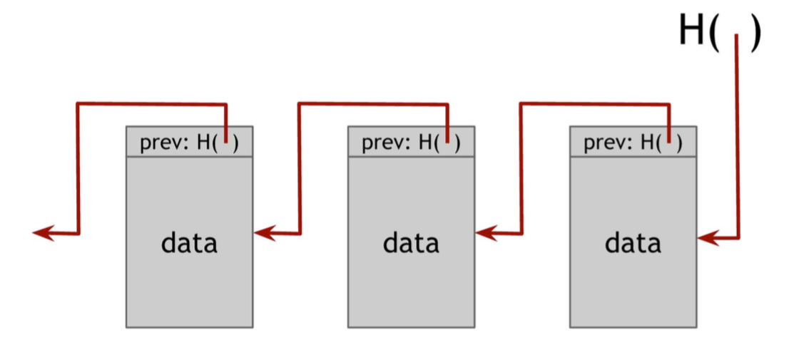
Concepts of Blockchains
Hash Pointer:
Is pointer where information is stored together with cryptographic hash. Hash pointer gives more flexibility than normal pointer to verify that information is not changed.
Data Structures using Hash Pointers
Blockchains:
A blockchain linked list that uses hash pointer instead of normal pointer. By using hash pointer each block not only tells about value of previous block but also digest of the value that allows to verify that the information hasn’t changed . Block Chains are tamper resist. If anyone tries to change data in any block hash value changes which don’t match with succeeding block.

Slide 5
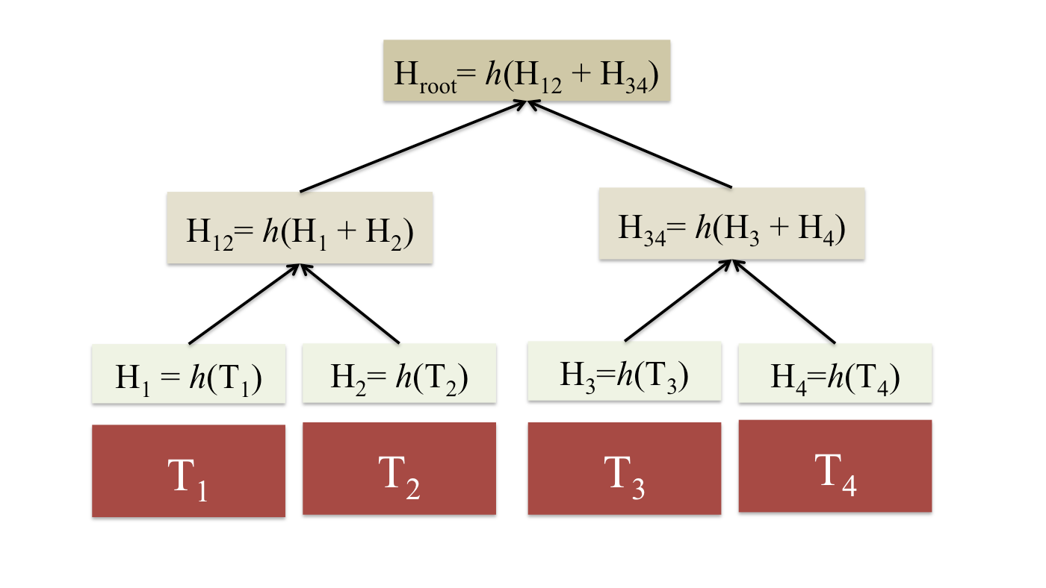
Concepts of Blockchains C0NT..
Merkle Tree:
Is Binary Tree with hash pointers. Hash of blocks are stored in parent nodes. Merkle Trees are tamper resistant. If anyone wants to tamper a block at bottom of the tree, that will cause hash pointer one level up to not match and he has tamper to root of the tree where he is not able to change. Proof of membership can be checked in log(n) time.

Slide 6
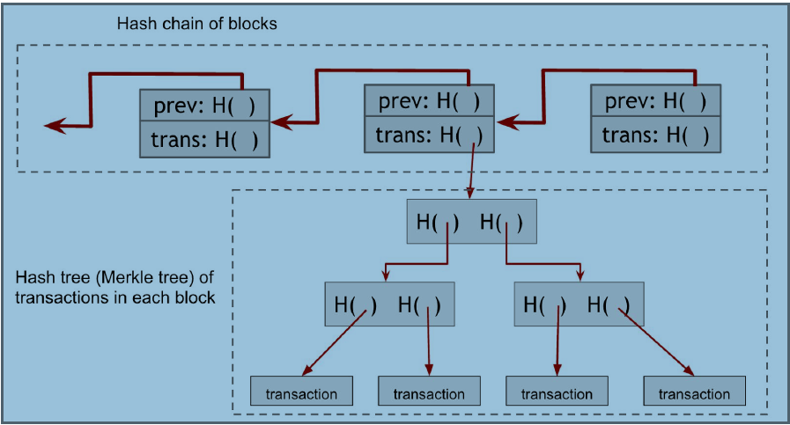
Concepts of Blockchains C0NT..
Bitcoin Blockchains:
Bitcoin Blockchains are combination of blockchains and Merkle tree . Each block has a block header, a hash pointer to the previous block in the sequence. Second data structure is Merkle Tree internal to each block. Information saved in block chain is tamper proof. Once message saved in blockchain. message will be saved forever.

Slide 7
Cryptography Technologies Used
SHA 256
SHA-256 uses compression function that takes input (file or image or text) and produces 256 bit output. Value of hash changes if the file is edited.
tools: openssl
PGP (Pretty Good Privacy)
PGP is used for signing encrypting , signing and decrypting files.
tools: openpgp ,keybase
Crypto Graffiti(Block Chain Encoder and Decoder):
encodes human readable text into bitcoin addresses.

Slide 8
Implementation of blockchain id
Take image
Edit Photograph with details
Sign edited image using PGP key (Pretty Good Protection)
Create hash digest of three files full image, edited image, signature of edited image.
Add Merkle root of latest transaction, hash of three files full image, edited image, signature of edited image.
Verify message posted in Block Chain
Edited Image can be used as self identity.

Slide 9
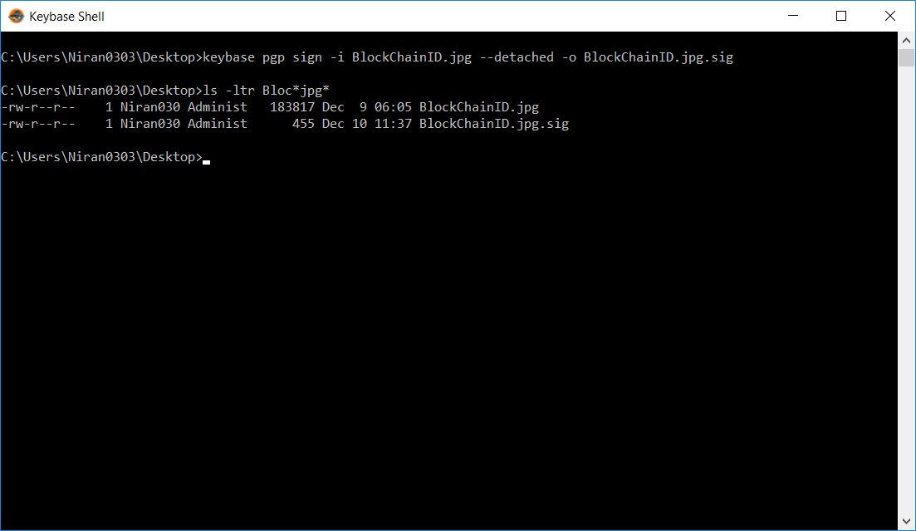
Sign Edited Image

Slide 10
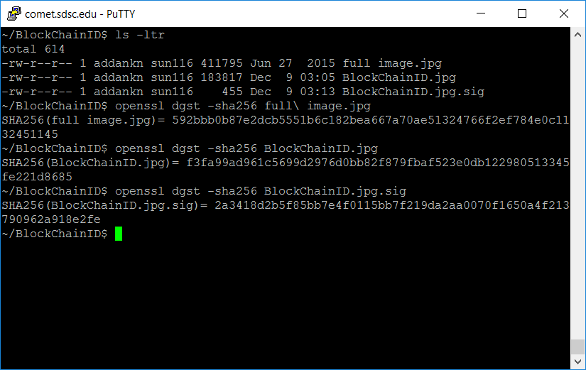
Hashing files

Slide 11
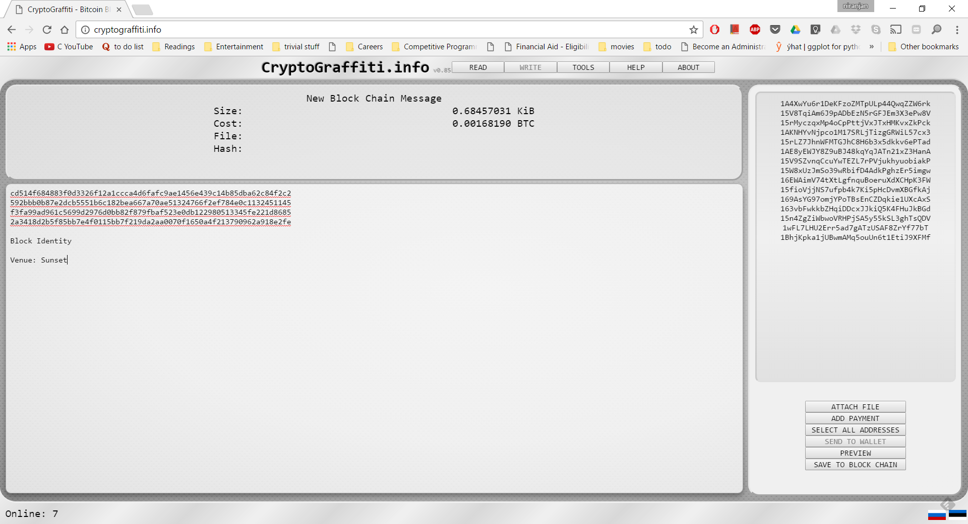
Stamping Message 0n BlockChain

Slide 12
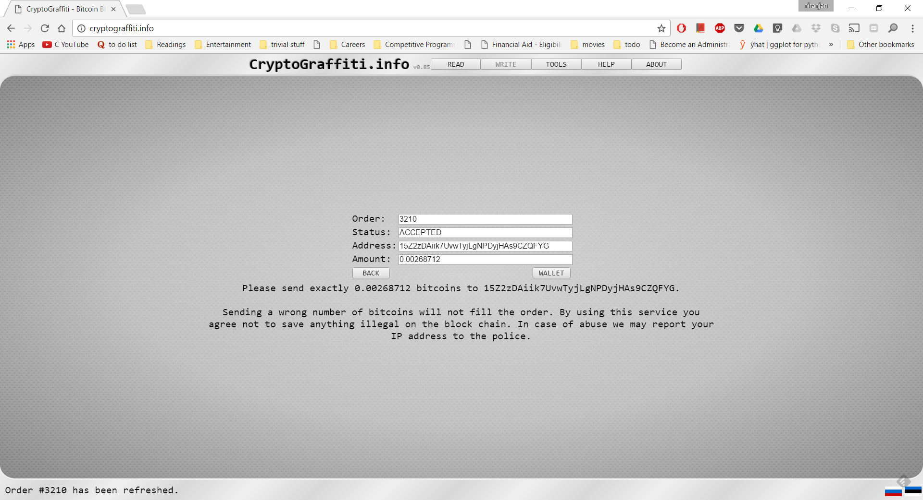
Stamping Message 0n BlockChain CNTD..

Slide 13
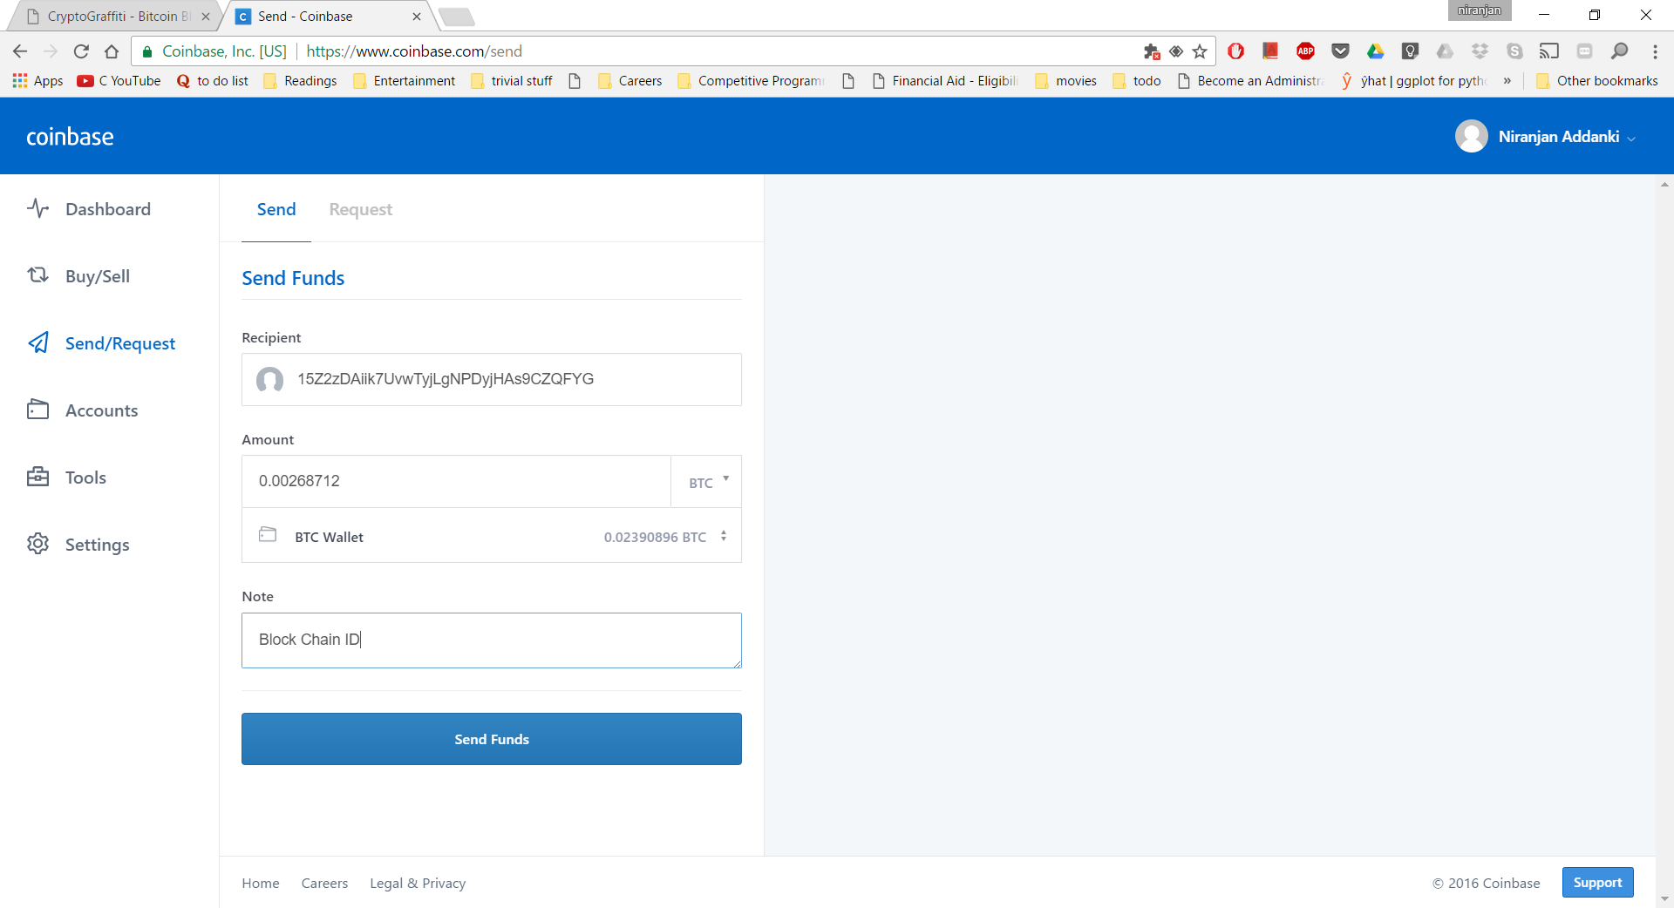
Confirming Transaction

Slide 14
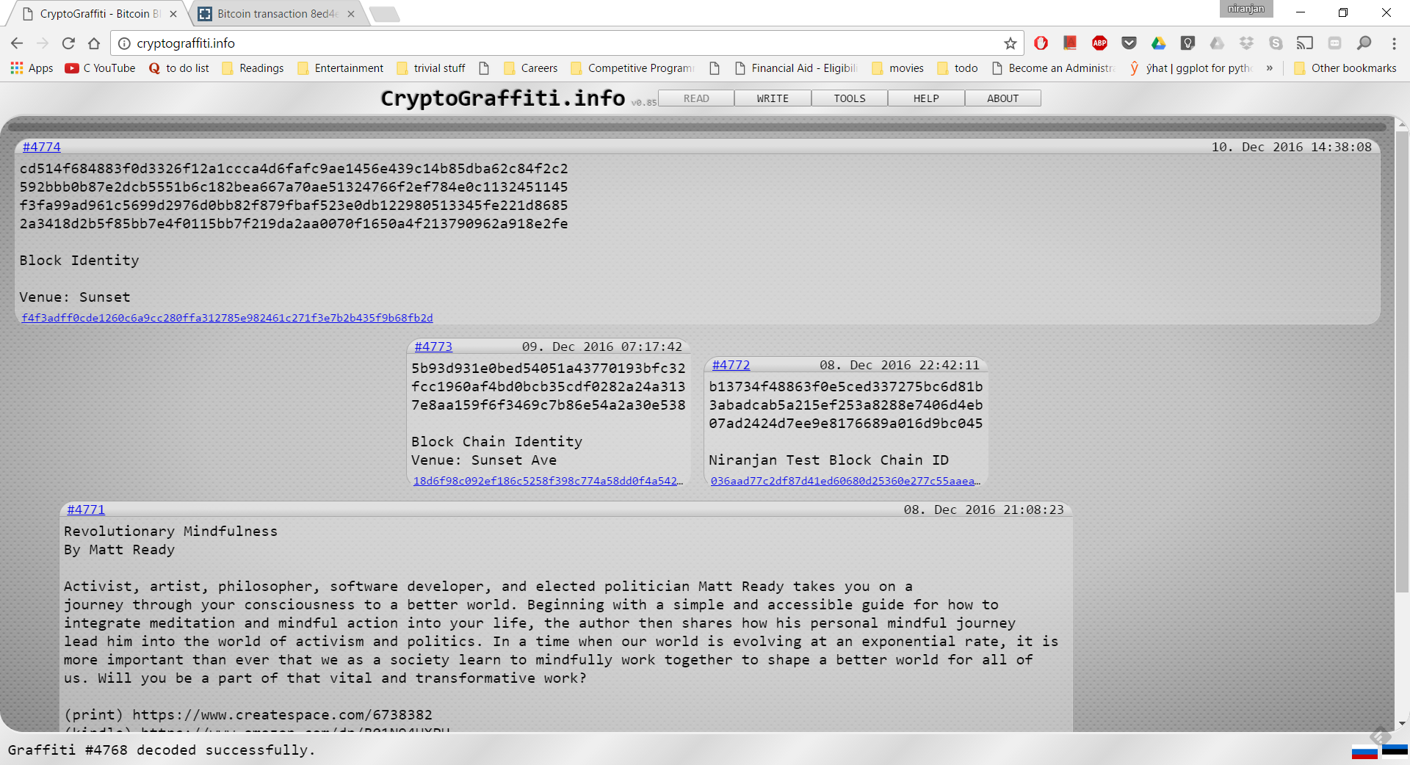
Message Posted on Block Chain

Slide 15
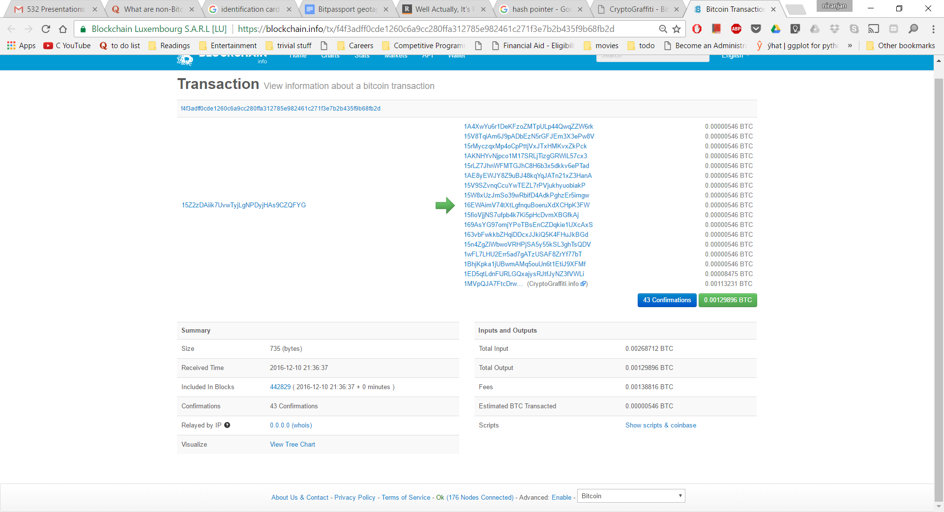
Block ChaIn Details

Slide 16
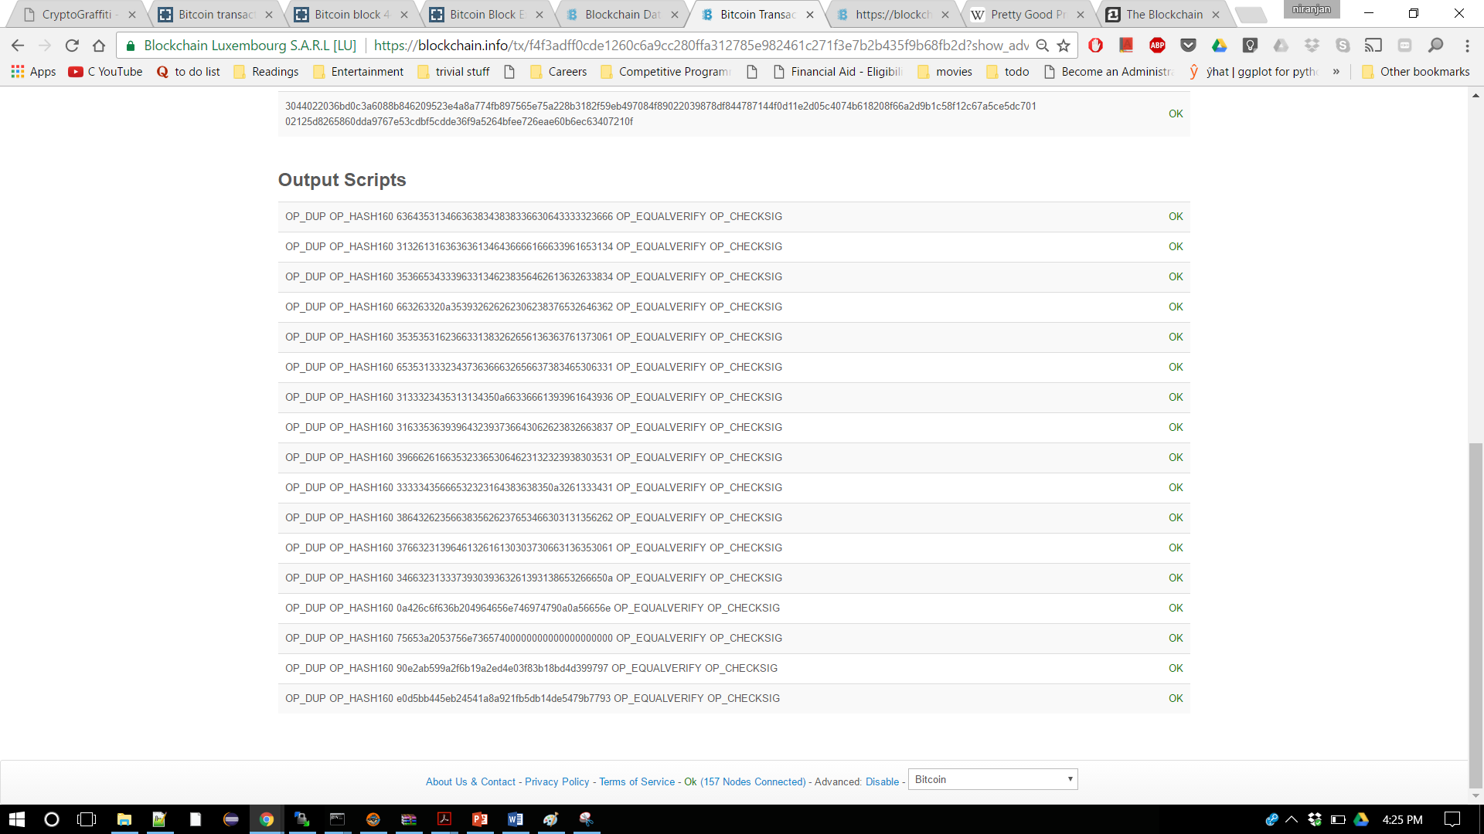
Blockchain details

Slide 17
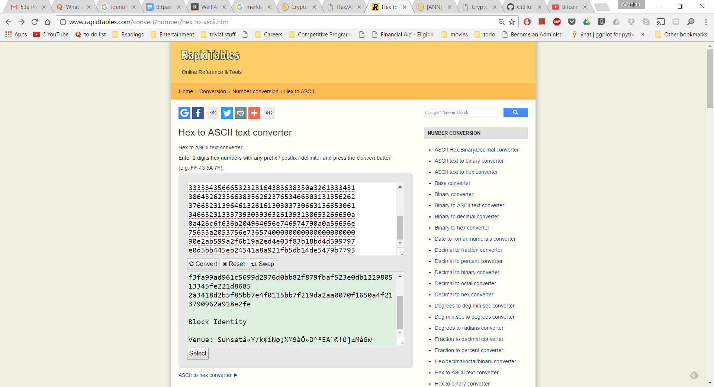
Hex to ascii

Slide 18
Output
Hash Hex
6364353134663638343838336630643333323666
3132613163636361346436666166633961653134
3536653433396331346238356462613632633834
663263320a353932626262306238376532646362
3535353162366331383262656136363761373061
6535313332343736366632656637383465306331
3133323435313134350a66336661393961643936
3163353639396432393736643062623832663837
3966626166353233653064623132323938303531
33333435666532323164383638350a3261333431
3864326235663835626237653466303131356262
3766323139646132616130303730663136353061
346632313337393039363261393138653266650a
0a426c6f636b204964656e746974790a0a56656e
75653a2053756e73657400000000000000000000
90e2ab599a2f6b19a2ed4e03f83b18bd4d399797
E0d5bb445eb24541a8a921fb5db14de5479b7793
Decoded msg:
cd514f684883f0d3326f12a1ccca4d6fafc9ae1456e439c14b85dba62c84f2c2
592bbb0b87e2dcb5551b6c182bea667a70ae51324766f2ef784e0c1132451145
f3fa99ad961c5699d2976d0bb82f879fbaf523e0db122980513345fe221d8685
2a3418d2b5f85bb7e4f0115bb7f219da2aa0070f1650a4f213790962a918e2fe
Block Identity
Venue: Sunsetâ«Y/k¢íNø;½M9àÕ»D^²EA¨©!û]±MåGw

Slide 19
Conclusion
Blockchain technology is evolving at rapid speed. It has applications in many area of Our interest. When the problem is with trust and certainty, Blockchain technology provides solution it.

Slide 20
Future scope of work
Automate the process of creation ID
Maintain register/ledger like system on the block chain to track changes

Slide 21
Similar Ideas/Technologies
BitNation: Person identity
ShoCard: Store Identity Cards like driver license, Passport
Storj: Decentralized cloud storage
FollowMyVote: Online voting using block chain technology

Slide 22
References
Bitcoin and Cryptocurrency Technologies (Arvind Narayanan, Joseph Bonneau, Edward Felten,Andrew Miller, Steven Goldfeder)
https://github.com/MrChrisJ/World-Citizenship
http://fpif.org/yugoslovia_when_a_country_actually_is_wiped_off_the_map/
https://en.wikipedia.org/wiki/Pretty_Good_Privacy
https://en.wikipedia.org/wiki/SHA-2
https://en.wikipedia.org/wiki/Blockchain_(database)

Slide 23
Thank You

